Slide 1


Hotel Reservation Analysis with
SQL
By Mohamed Abdelfattah

Slide 2
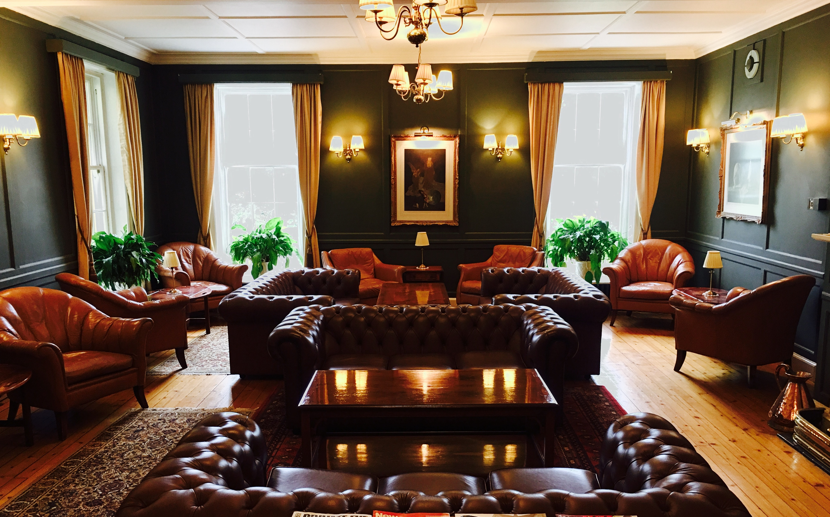
Dataset Details:
The dataset includes the following columns:
-Booking_ID: A unique identifier for each hotel reservation.
- no_of_adults: The number of adults in the reservation.
- no_of_children: The number of children in the reservation.
- no_of_weekend_nights: The number of nights in the reservation that fall on weekends.
- no_of_week_nights: The number of nights in the reservation that fall on weekdays.
- type_of_meal_plan: The meal plan chosen by the guests.
- room_type_reserved: The type of room reserved by the guests.
- lead_time: The number of days between booking and arrival.
- arrival_date: The date of arrival.
- market_segment_type: The market segment to which the reservation belongs.
- avg_price_per_room: T he average price per room in the reservation.
- booking_status: The status of the booking.
By Mohamed Abdelfattah

Slide 3
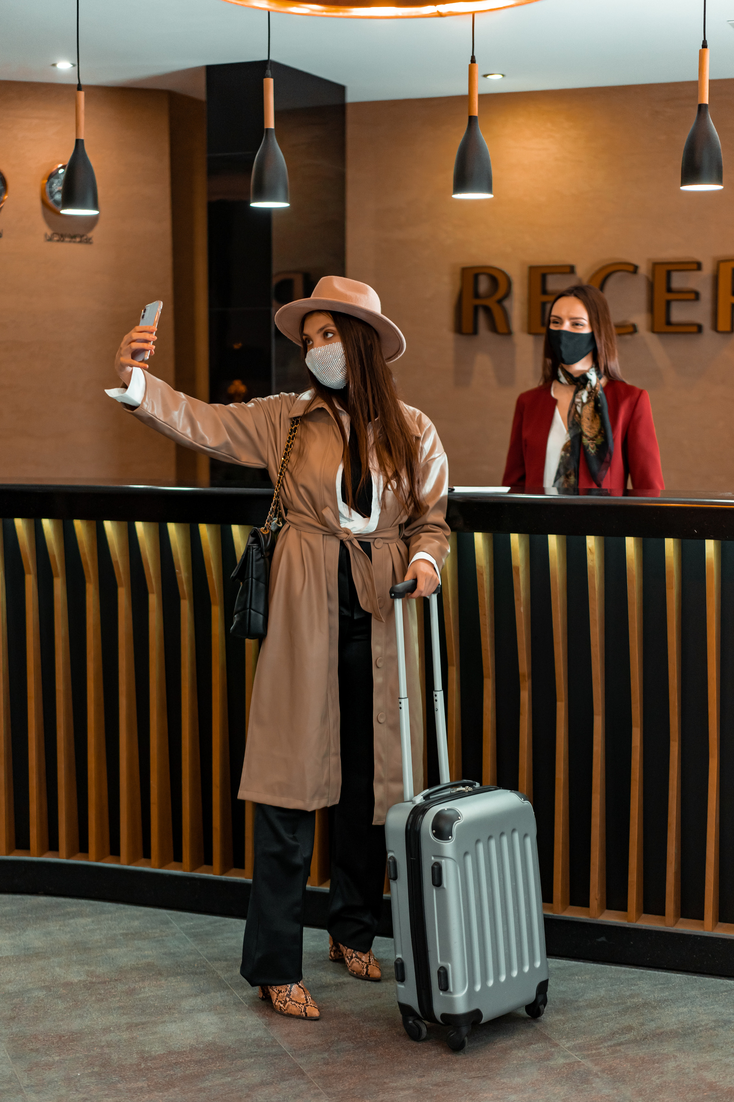
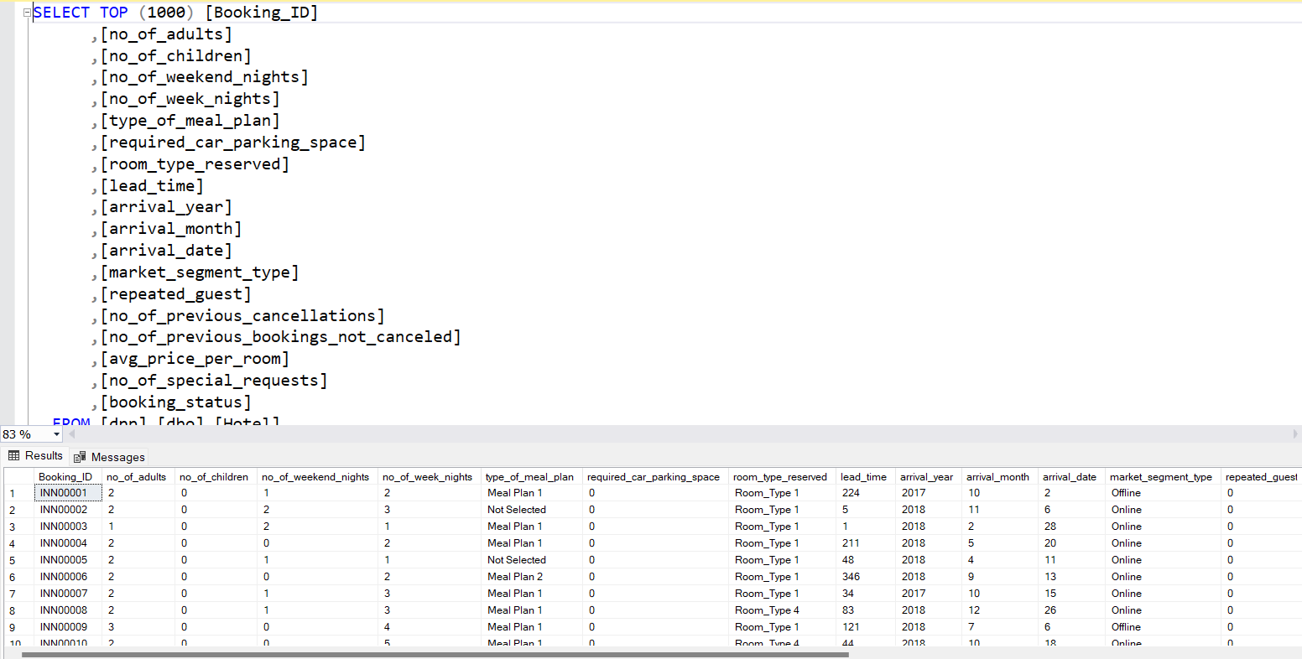
About the Dataset

Slide 4

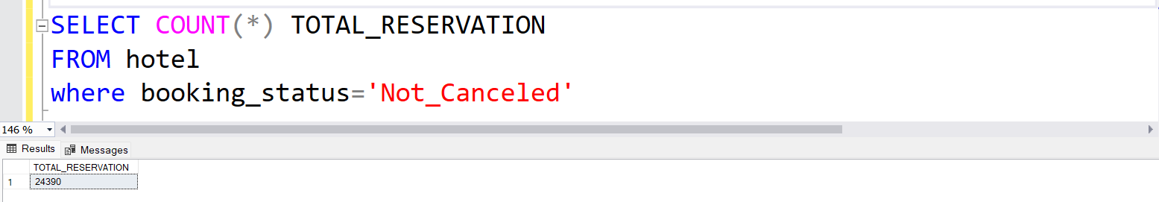
What is the total number of reservations in the dataset?
By Mohamed Abdelfattah

Slide 5
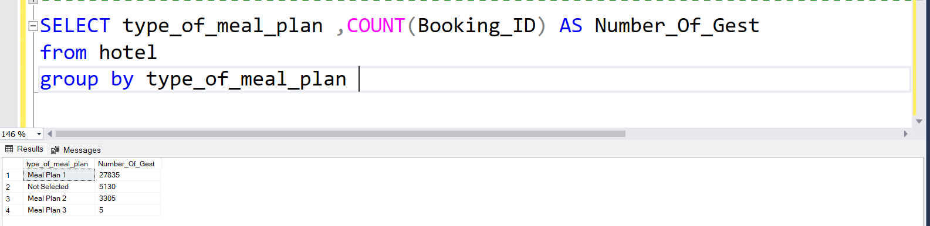
Which meal plan is the most popular among guests?
By Mohamed Abdelfattah

Slide 6
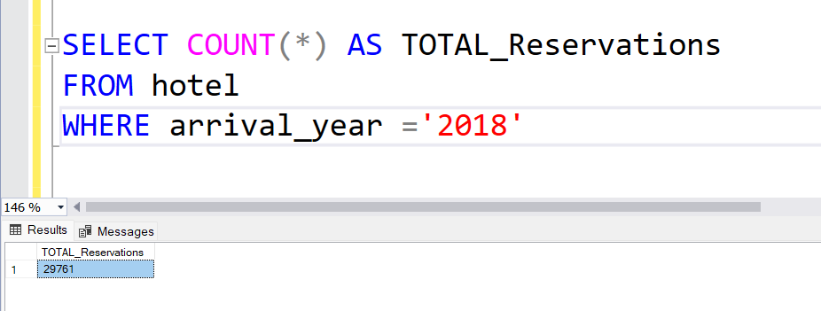
How many reservations were made for the year 20XX ?
By Mohamed Abdelfattah

Slide 7
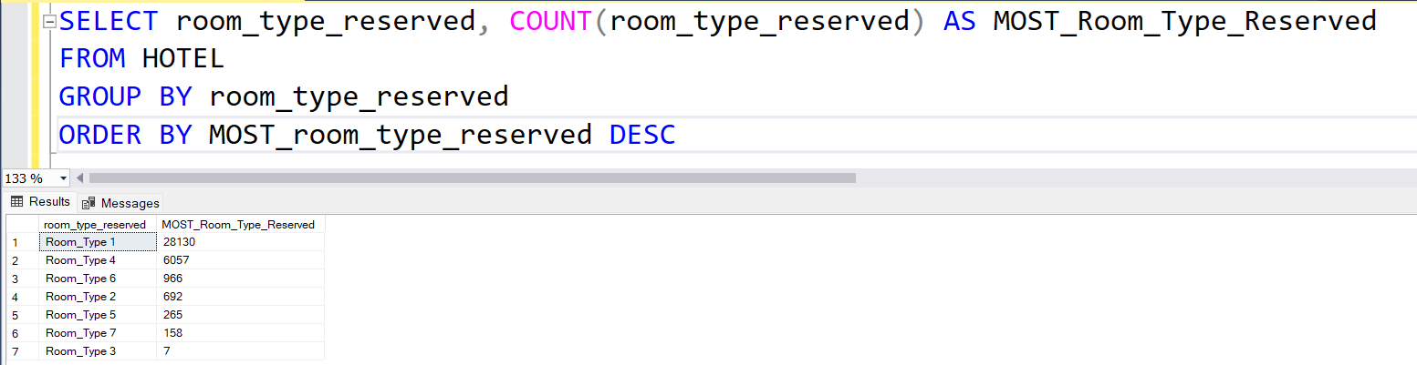
What is the most commonly booked room type?
By Mohamed Abdelfattah

Slide 8
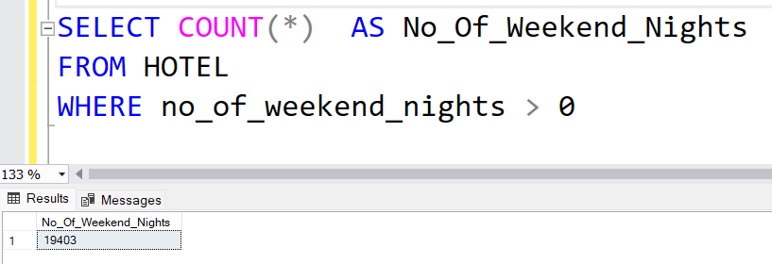
How many reservations fall on a weekend (no_of_weekend_nights > 0)?
By Mohamed Abdelfattah

Slide 9
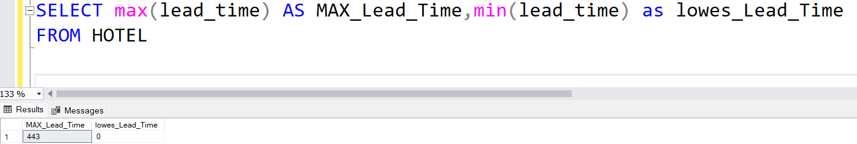
What is the highest and lowest lead time for reservations?
By Mohamed Abdelfattah

Slide 10
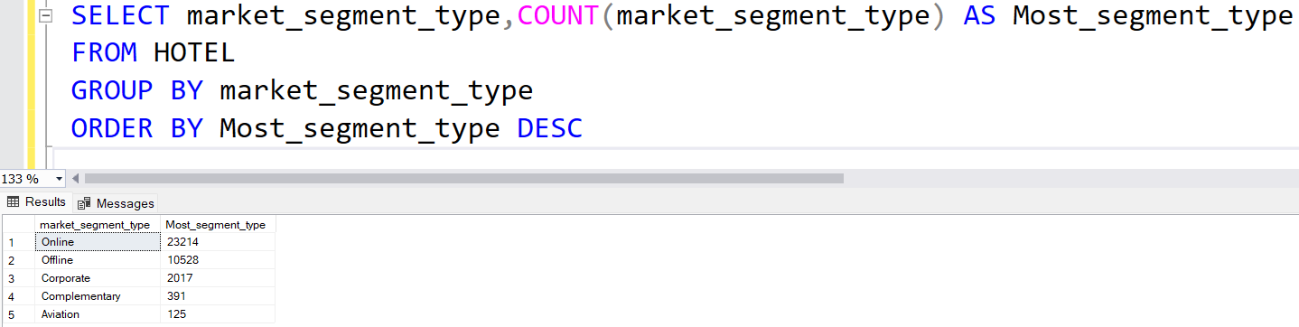
What is the most commonly booked room type?
By Mohamed Abdelfattah

Slide 11
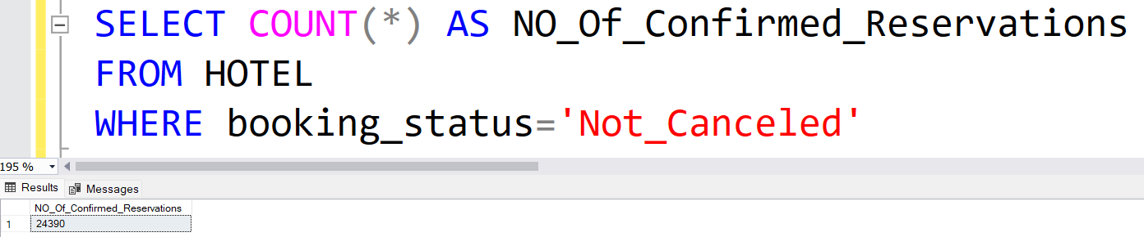
How many reservations have a booking status of "Confirmed"?
By Mohamed Abdelfattah

Slide 12
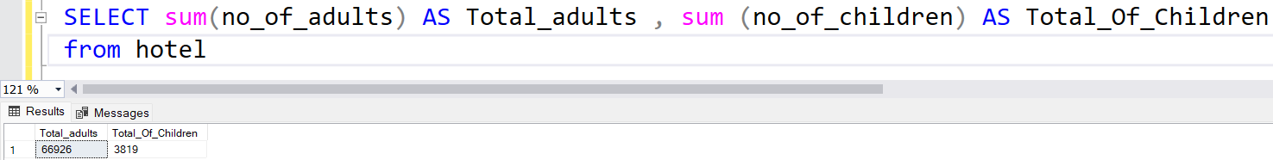
What is the total number of adults and children across all reservations?
By Mohamed Abdelfattah

Slide 13
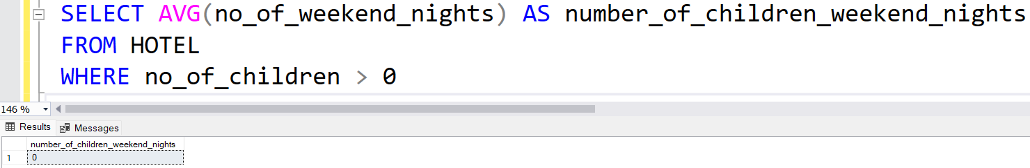
What is the average number of weekend nights for reservations involving children?
By Mohamed Abdelfattah

Slide 14
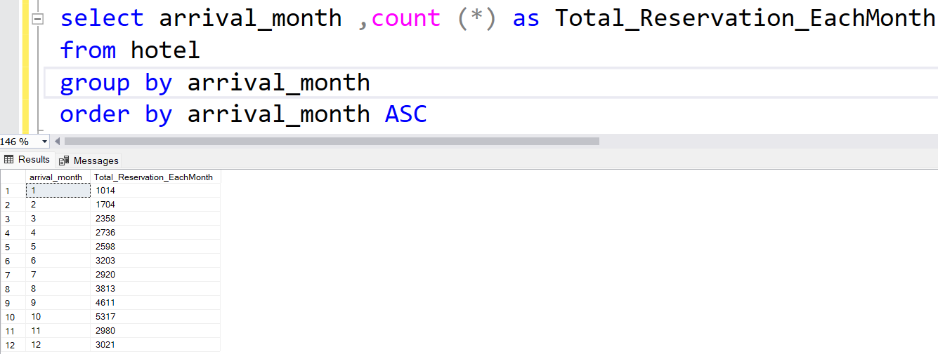
How many reservations were made in each month of the year?
By Mohamed Abdelfattah

Slide 15
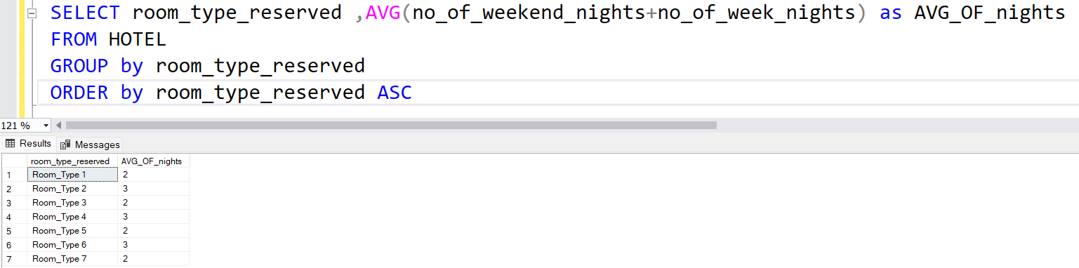
What is the average number of nights (both weekend and weekday) spent by guests for each room
type?
By Mohamed Abdelfattah

Slide 16
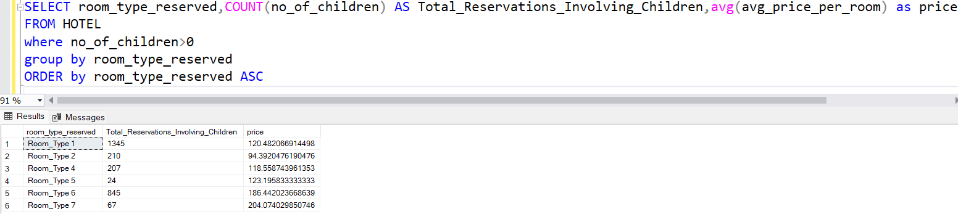
For reservations involving children, what is the most common room type, and what is the average
price for that room type?
By Mohamed Abdelfattah

Slide 17
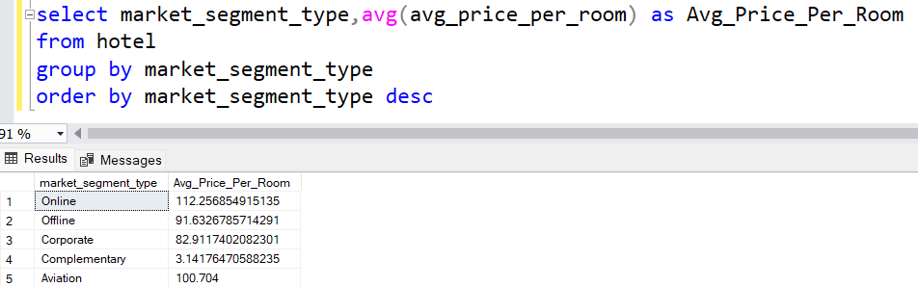
Find the market segment type that generates the highest average price per room.
By Mohamed Abdelfattah

Slide 18

Thank You
By Mohamed Abdelfattah

